Slide 1
WORD GUESSING GAME
Using python

Slide 2
IMPORTANCE AND OVERVIEW
This Word guessing game can be useful to improve the vocabulary. While also enjoying the thrill of a game.
One player thinks of a word or phrase; the others try to guess what it is one letter at a time. The player draws a number of dashes equivalent to the number of letters in the word.
And gives a hint. (E.g. This is a fruit.)
If a guessing player suggests a letter that occurs in the word, the other player fills in the blanks with that letter in the right places.

Slide 3
The word to guess is represented by a row of dashes representing each letter of the word. If the guessing player suggests a letter which occurs in the word, the other player writes it in all its correct positions. If the suggested letter does not occur in the word, there will be reduction of one of your tries.
The player guessing the word may, at any time, attempt to guess the whole word. If the word is correct, the game is over and the guesser wins.
On the other hand, if player run out of tries, the guesser loses.
However, the guesser can also win by guessing all the letters that appear in the word, thereby completing the word, before running out of tries.

Slide 4
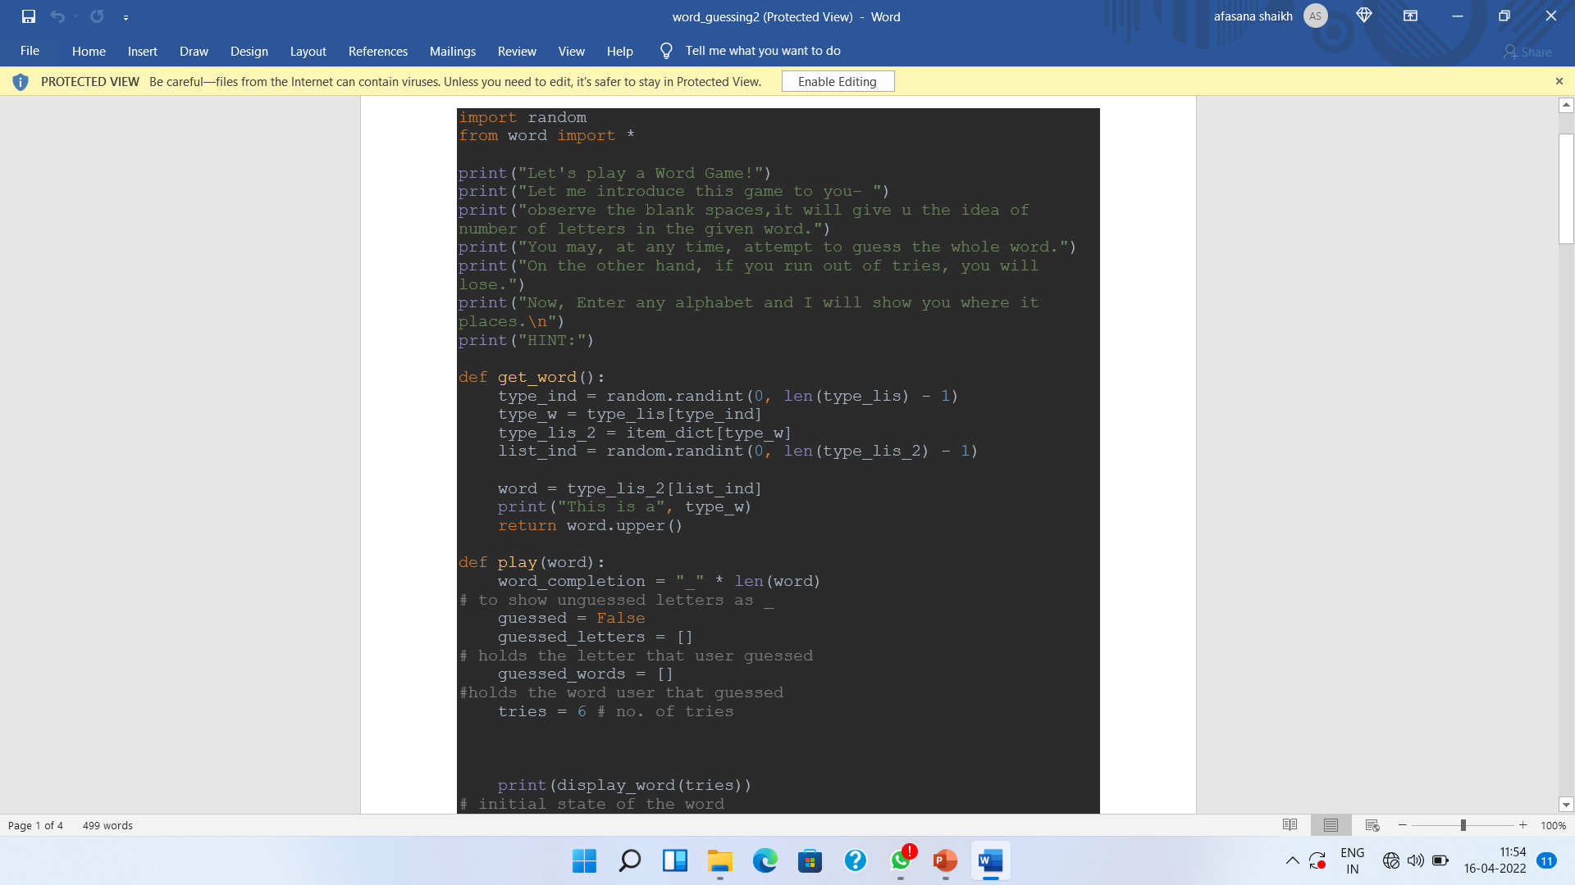
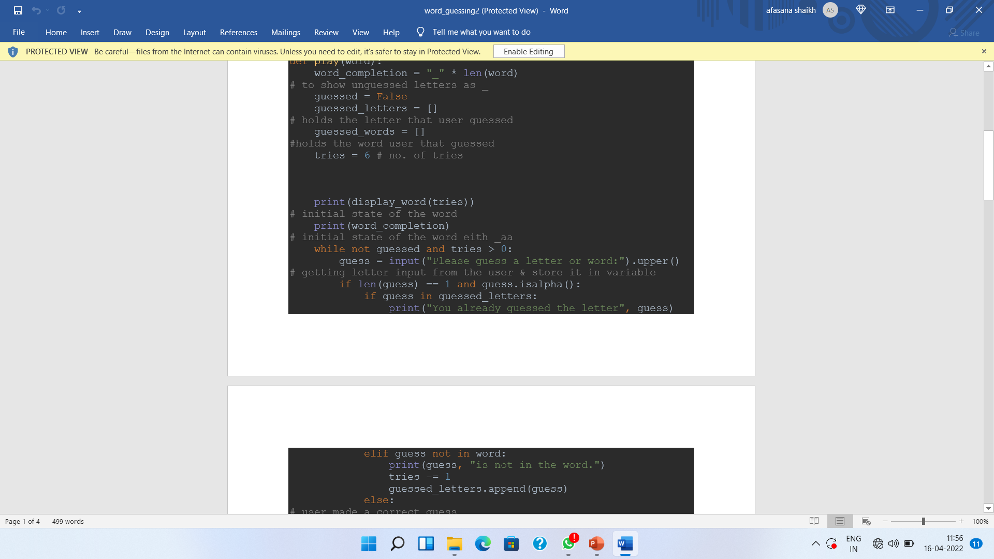
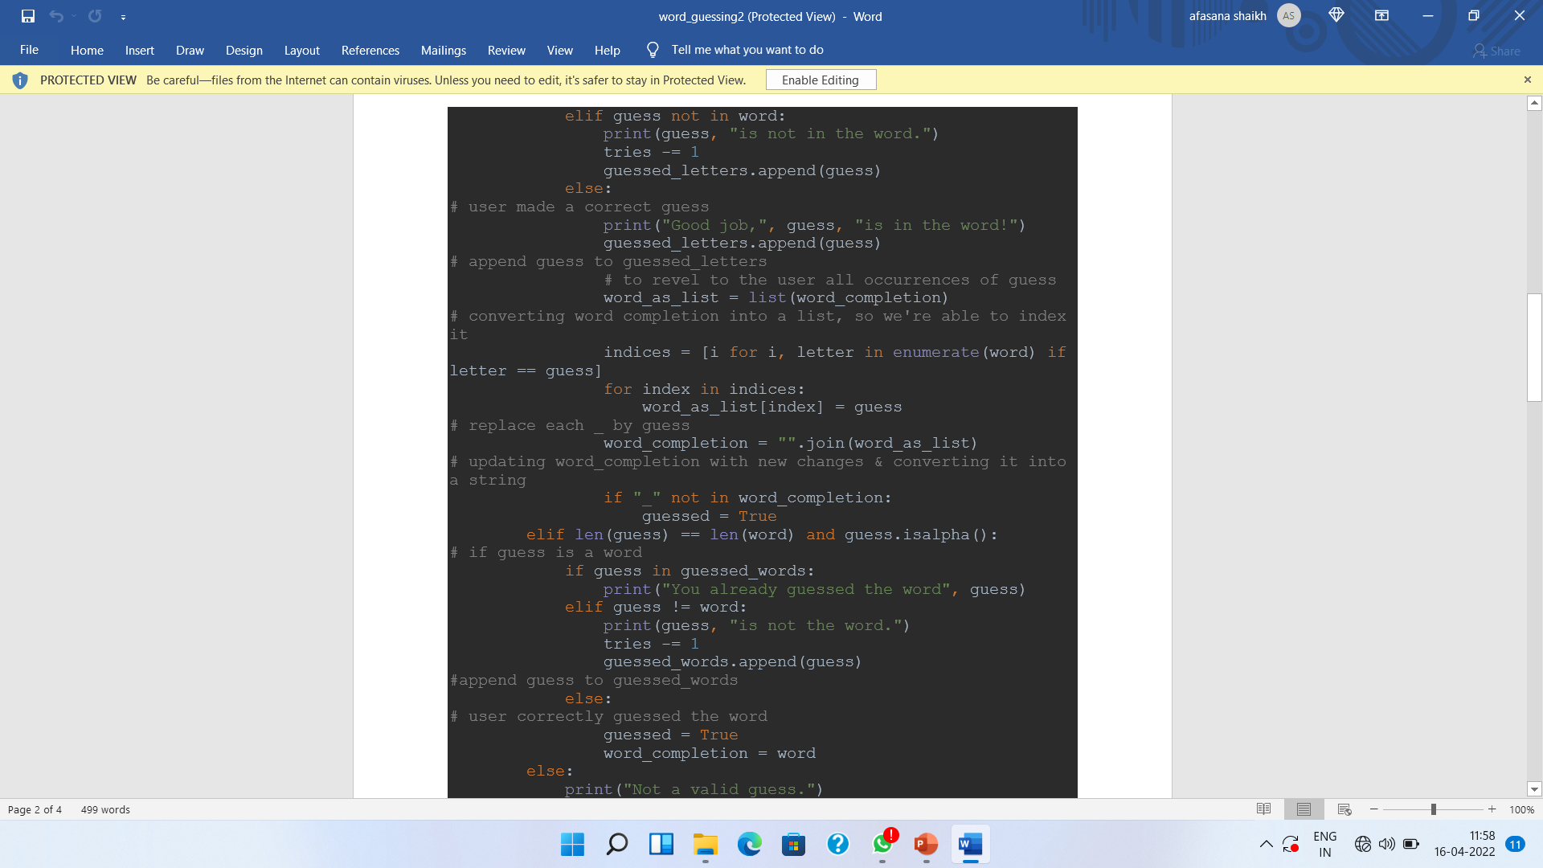

Slide 5
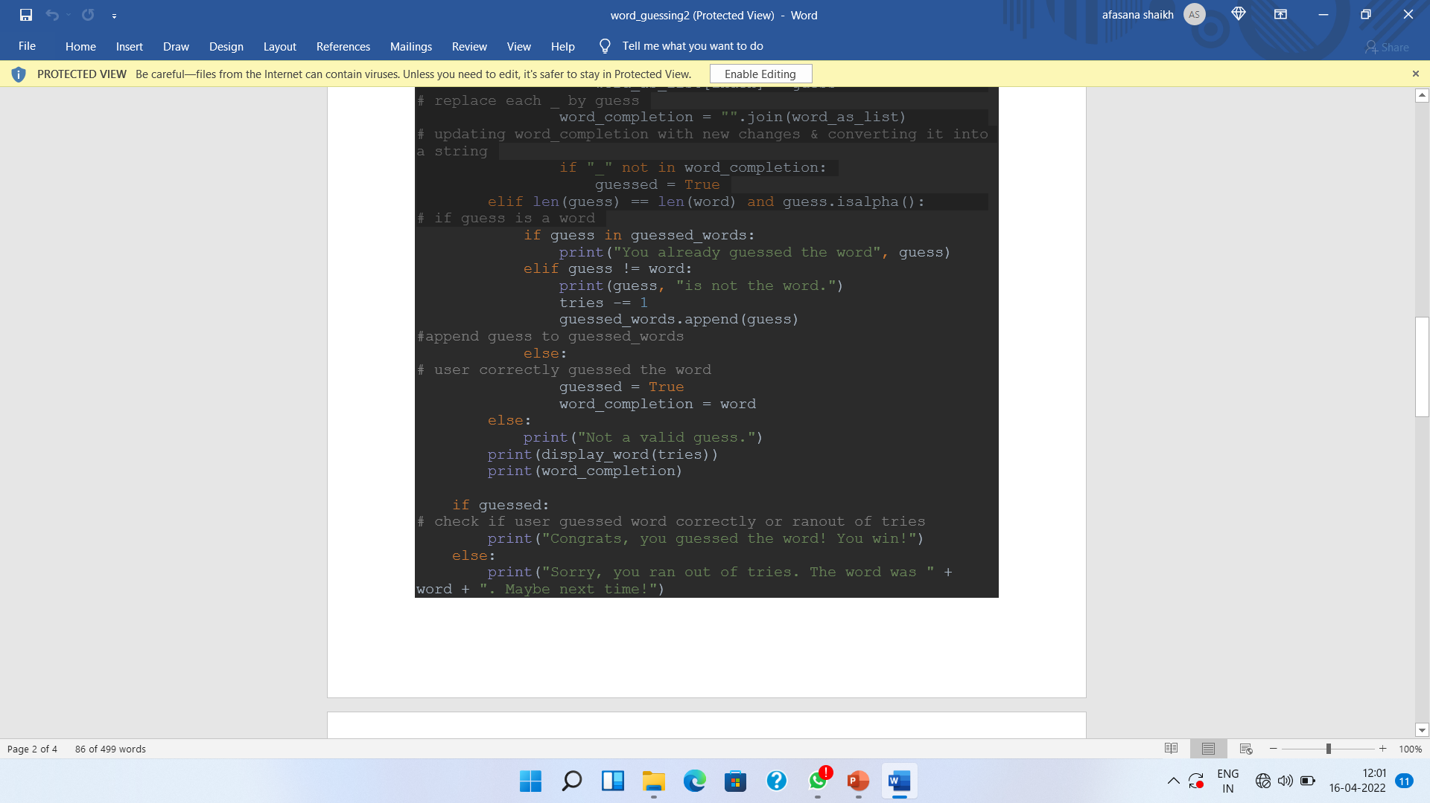
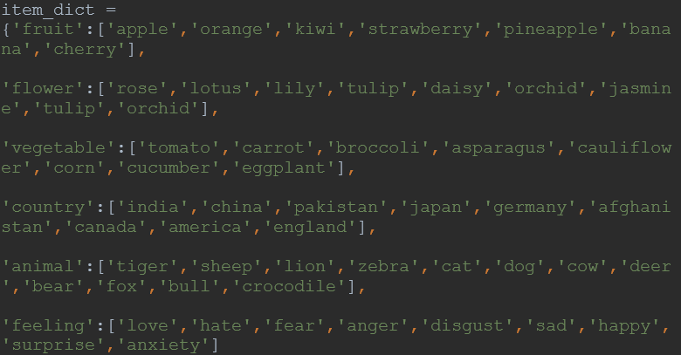
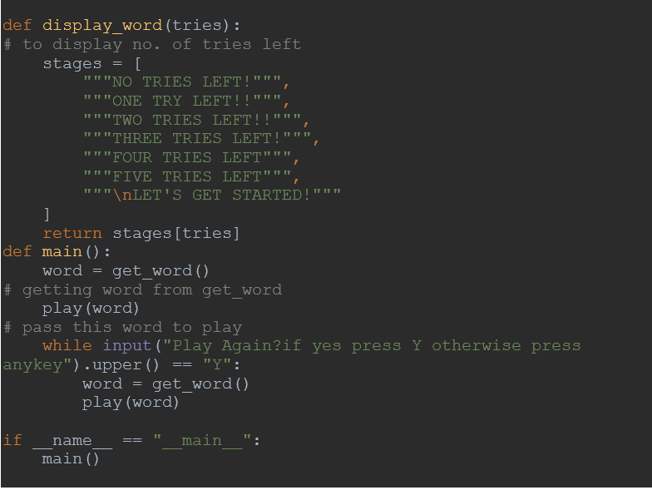

Slide 6
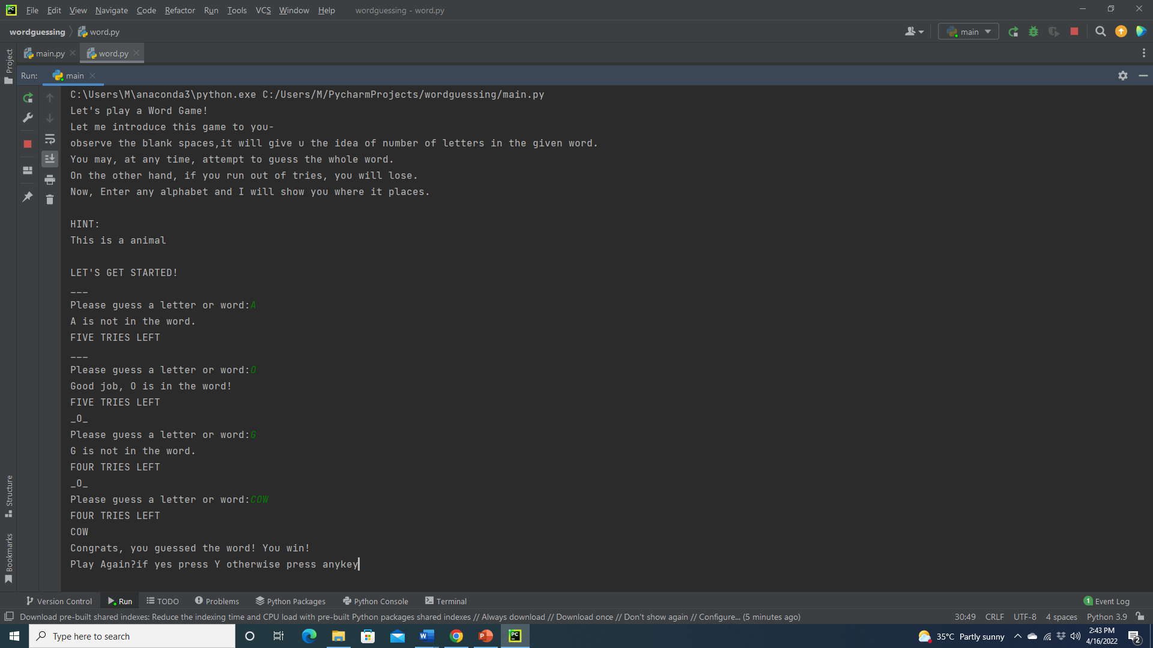
SAMPLE OUTPUT

Slide 7
Introduction To Game
In this game, there is a list of words present, out of which our interpreter will choose 1 random word.
Player will be asked to guess any alphabet. If the random word contains that alphabet, it will be shown in the output(with correct placement) else the program will ask you to guess another alphabet.
User will be given 6 turns(reduction of one try on wrong guess) to guess the complete word.

Slide 8
RANDOM
The Python standard library provides a module called random.
Which allows us to randomly pick words from our words list.
As this game is a paper and pencil guessing game for two or more players. One player thinks of a word, phrase or sentence and the other tries to guess it by suggesting letters within a certain number of guesses.

Slide 9
Group members
Miss .Subhana Ayub Shaikh.
PRN-19UET042
Miss .Minal Sunil Upadhye.
PRN-19UET050

Slide 10
THANK YOU

